Slide 1
React JS Online Training 2020
By NAVEEN SAGGAM
From UiBrains Technologies

Slide 2
What is React JS
It’s an open source library to build Rich User Interfaces
Used to develop Single Page Applications
Developed & Maintained by Facebook
Released in 2013
Current version 16.13.1 (March 2020)
Most popular front end library as of today along with Angular
Average Salary in India around 735k (INR). (payscale.com)
Average Salary in USA around $91k (payscale.com)

Slide 3
Pre-Requisites
Basic Knowledge on HTML
Basic Concepts on CSS
Good Understanding of JavaScript with Functions
Recommended with JavaScript callback & promises & ES6 Features
Bootstrap knowledge is added advantage
Visit : UiBrains Technologies YouTube Channel for above tech Stack.

Slide 4
React JS Learning Plan
React Basic Module
React
Hooks
Redux , Thunk , Saga
Node , Express , MongoDB
Material UI
Prime React Components
Final
Project

Slide 5

React JS Basic Module
Creation of First Application using react-app & folder structure
Creation of custom component with class & functional
Applying styles using CSS , Inline , Internal , External
Adding Bootstrap to React JS Application & Examples
Manage Props & States in Custom Components
Events Handlings in React JS with Examples
Form Handlings in React JS with Examples
Conditional & List Rendering in React JS
Components Life-Cycle in React JS
Context API in React JS
HTTP Calls in React JS using Axios (GitHub Profile Search Application)
React Routing Concept & Examples
Big Basket Application using React JS

Slide 6


React JS Hooks
Hooks are a new addition in React 16.8. They let you use state and other React features without writing a class
Introduction to React Hooks
useState Hook
useEffect Hook
useRef Hook
useContext Hook
useReducer Hook
Big Basket Application Using Hooks

Slide 7


Redux , Thunk , Saga
Introduction to plain Redux with Examples
Using multiple Reducers
Implement Redux with React JS with examples
useSelector() , useDispatch() Examples
Redux-Logger Configuration
Redux-Dev Tools Configuration for Debugging
Redux-Thunk Configuration & Examples
Introduction to React Saga
Big Basket Application with Hooks & Redux

Slide 8

Introduction to Material UI
React components for faster and easier web development. Build your own design system, or start with Material Design
Layout Components
Input Components
Navigation Components
Data Display Components

Slide 9

Introduction to Prime React
The ultimate collection of design-agnostic, flexible and accessible React UI Components.
Input Components
Buttons
Data Components
Panels in Prime React

Slide 10

Unit Testing with React JS
Introduction to Unit Testing
Introduction to Test Driven Development
Integration of JEST Framework with React
Generation of Test Coverage Reports
Integration of other Testing libraries

Slide 11




Server Side Integration
Implementation of Node JS Server with Routing
Implementation of Express JS with Routing
Introduction to REST API and Development
Integration of Mongo DB with local & Cloud
Developing Models with Mongoose Library

Slide 12




Other Libraries Integration

Slide 13

Final Project (E-Commerce App)
Bootstrap Layout with Responsive side nav with Full Page landing page
Implementation of React Routing & Navigation for various links
JSON Web Token (JWT) based Authentication
Image upload functionality for products
Server side with Node , Express JS with Mongo DB integration
Backend Data modeling with Mongoose
Stripe Payments integration for products purchase
Final Application Deployment to Heroku App
Future implementations of the projects

Slide 14

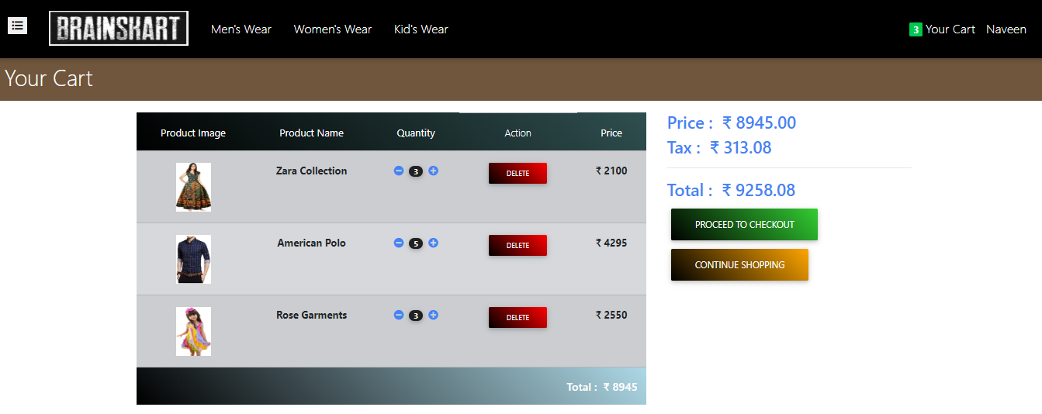
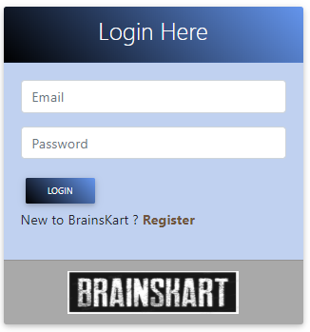
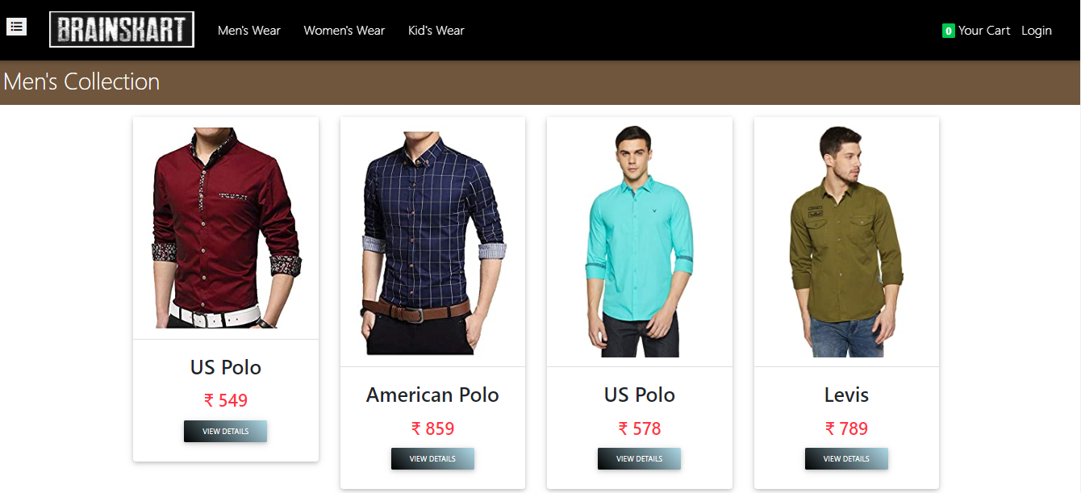
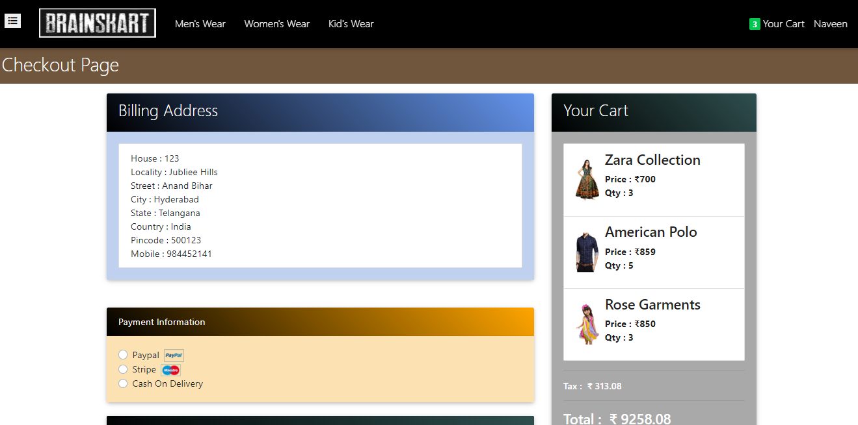
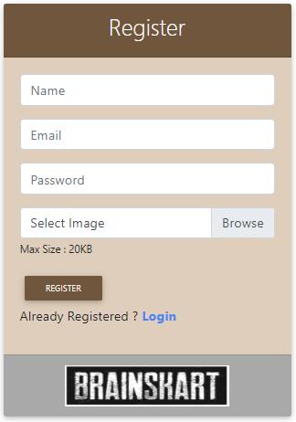
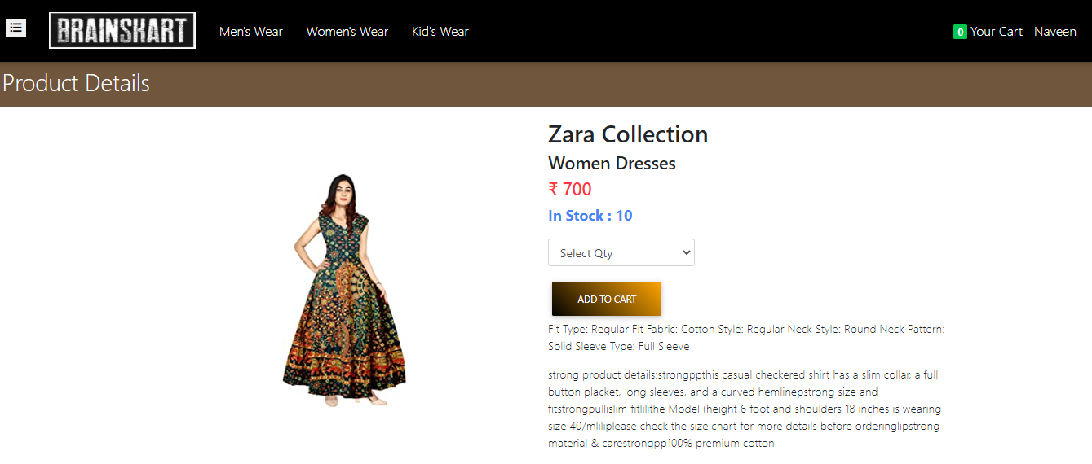
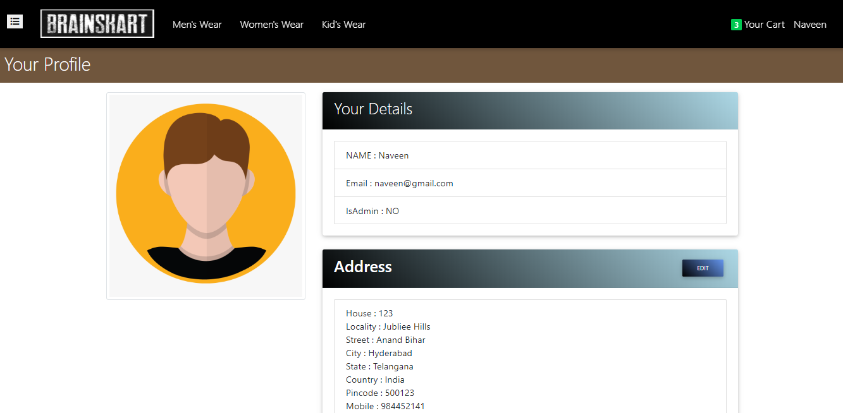
Real
Images

Slide 15
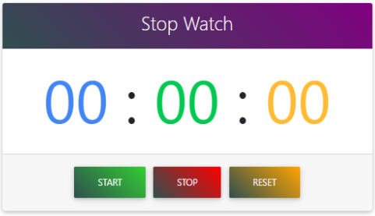
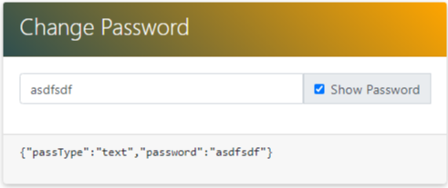
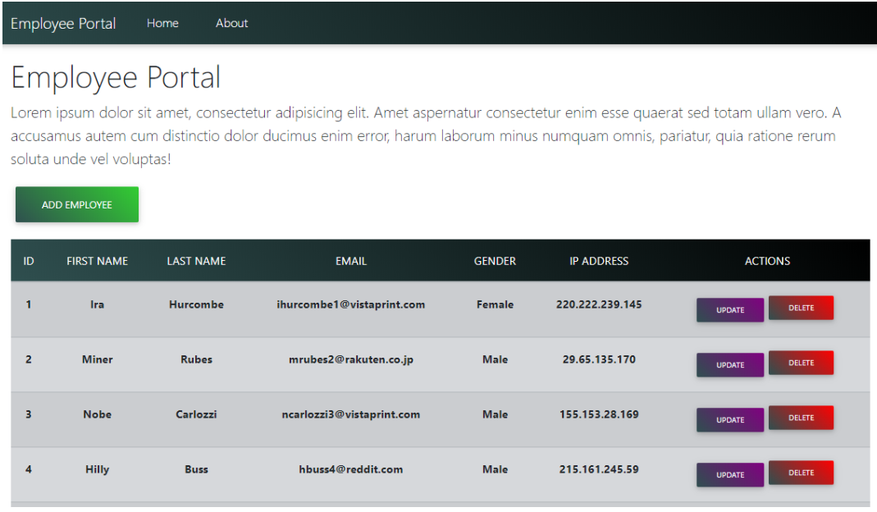
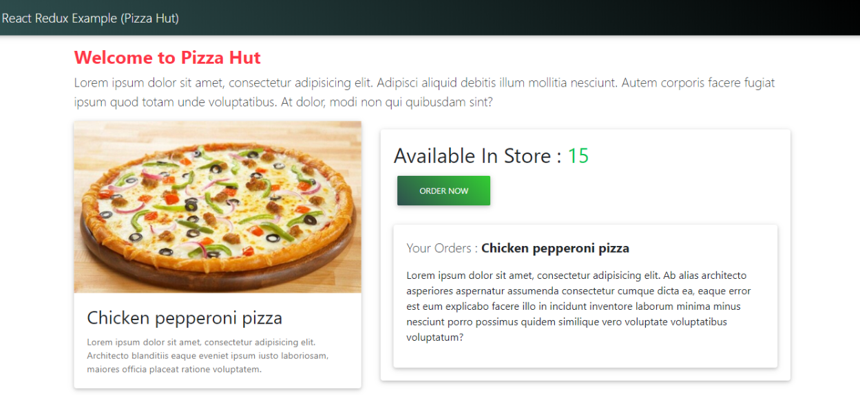
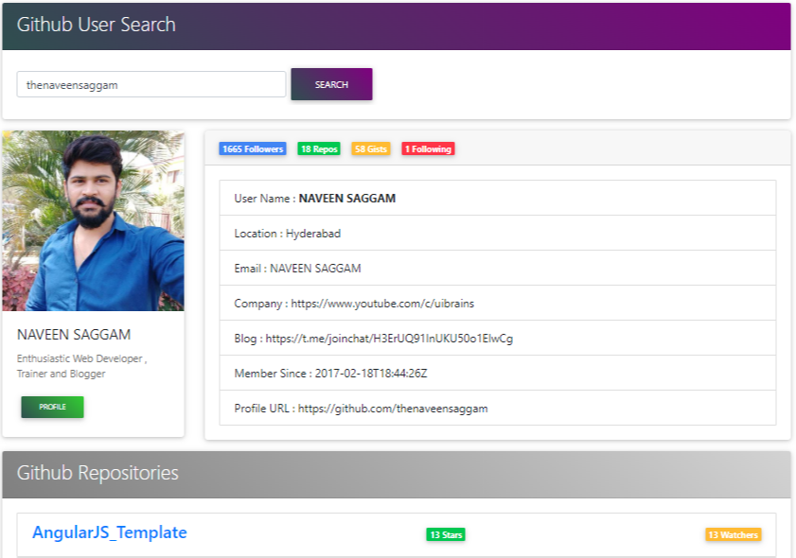
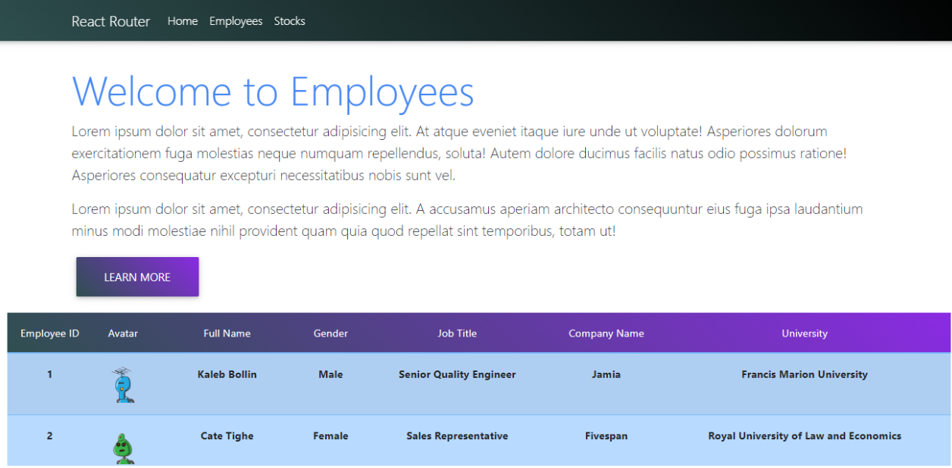
Other Applications

Slide 16
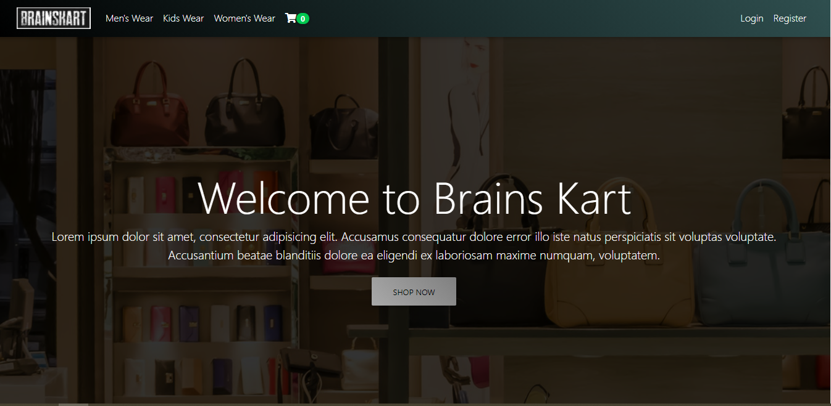
Live Demo

Slide 17
Course Information
Total Duration 45days (90 hrs.)
Live & Hands-on Training on Each Technology
Covers basics to Advanced level with App Development
Daily videos , Files , Slides Sharing for Practice
Class Timings 8PM – 10PM IST(Daily 2hrs)
Monday - Saturday (Sunday Holiday)
Course Fee : 6000 INR for (Indian Student)
$85 US-Dollars for (Others Students)
Google pay to : +91-98 44 80 45 33

Slide 18













Software Installation
Notepad++
Node JS
Mongo DB
Insomnia / Postman
Heroku
Git
TypeScript
Editors (WebStorm / Visual Studio Code)
UiBrains

Slide 19

Any Queries ?

Slide 20
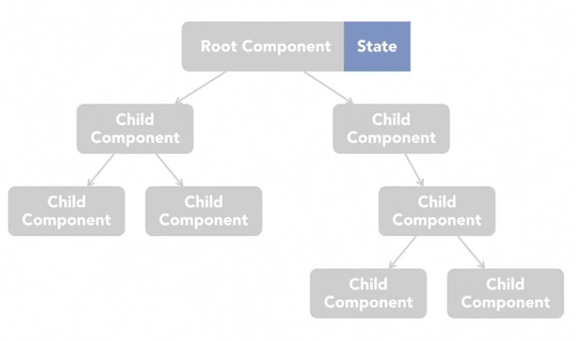
Best way to handle state in application

Slide 21
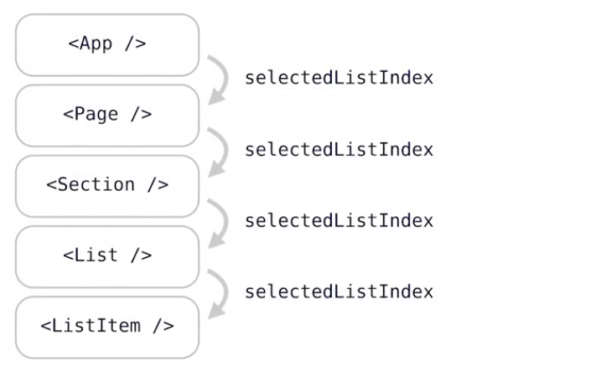
Props Drilling

Slide 22
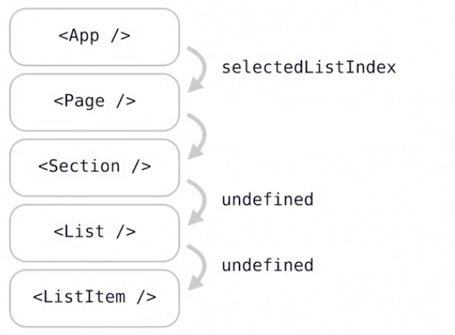
Props Drilling (Problem)

Slide 23
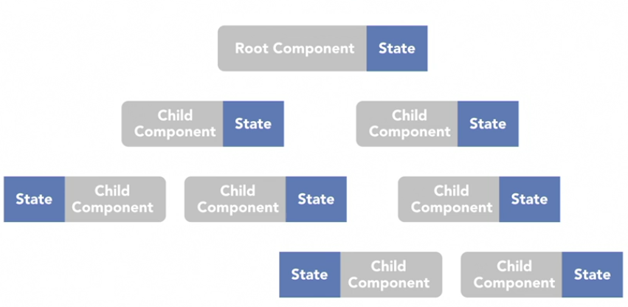
Each component with its own state

Slide 24
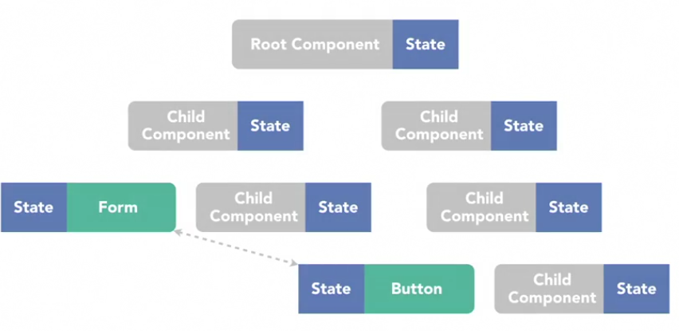
Each component with its own state (Problem)

Slide 25
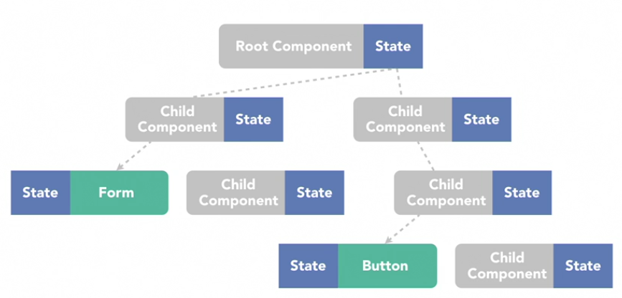
Each component with its own state (Problem)

Slide 26
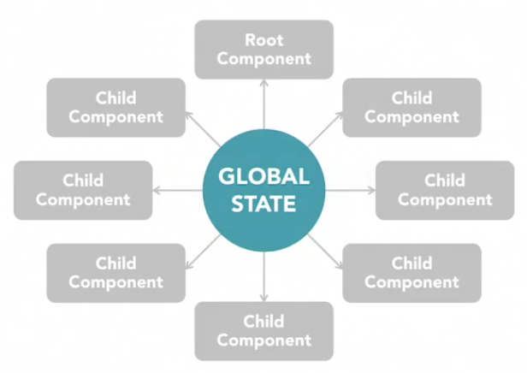
Manage State in the Global

Slide 27
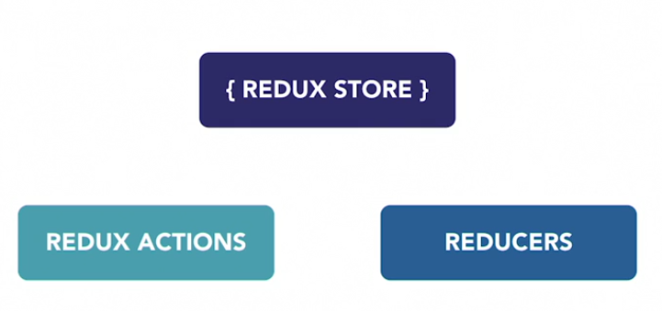
Redux Works

Slide 28
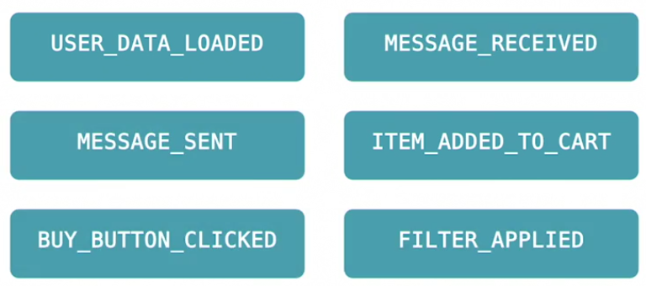
Redux Actions

Slide 29
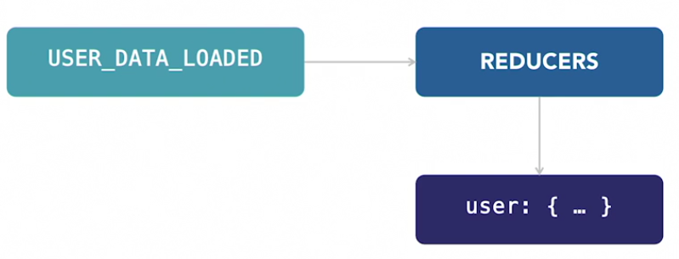
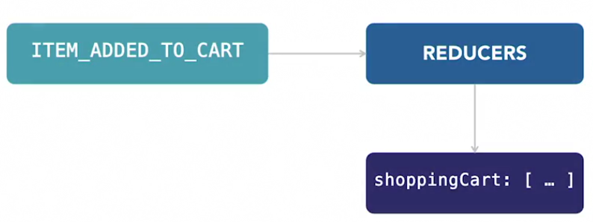
Redux Reducers

Slide 30
How Redux Works?
Each Component can only interact with the state by triggering actions
UI Triggers an Action
Reducer Updates the Store
Store Contains
App Data

Slide 31
Any Queries ?

